Slide 1
Integrity in Conflict
Inclusion BC 2019 Conference

Slide 2

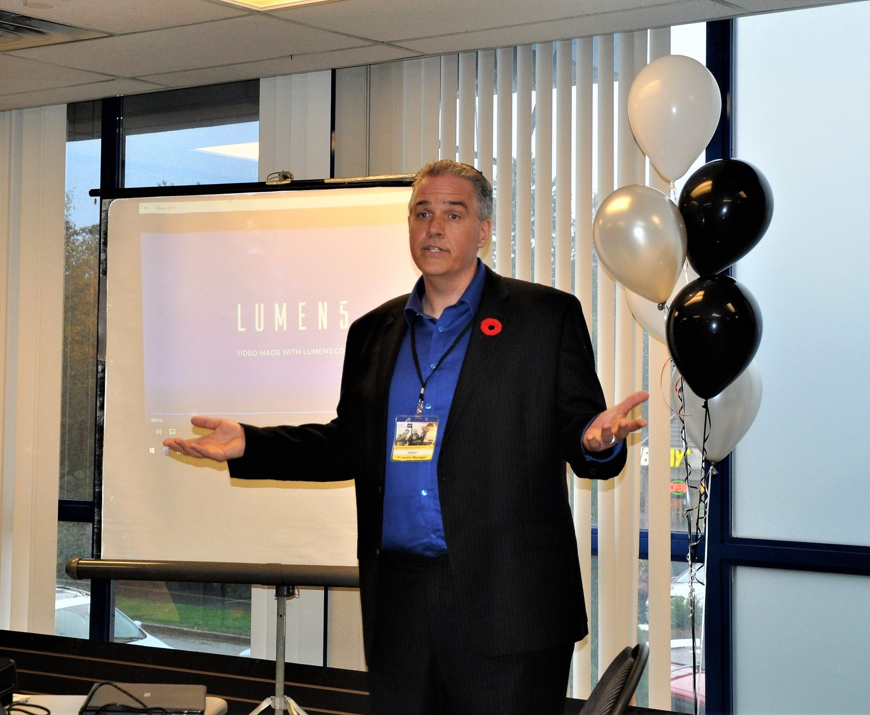
Who am I?
Program Manager at Leadership Victoria
Specialist in Values-Based Leadership Development
10 years experience in CLBC funded services

Slide 3
What will we do today?
Differentiate what is happening in our head, with what we would like to see happen.

Slide 4


Slide 5
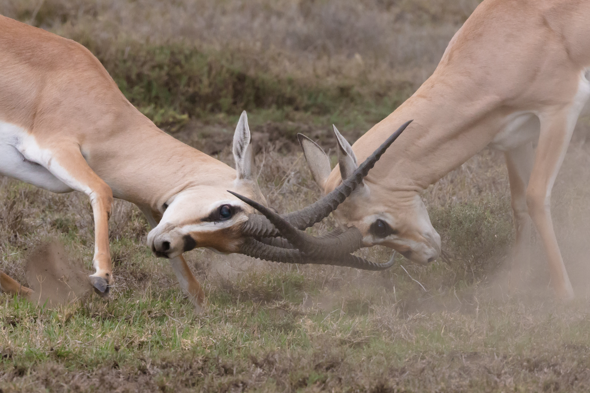
Conflict What is it?

Slide 6
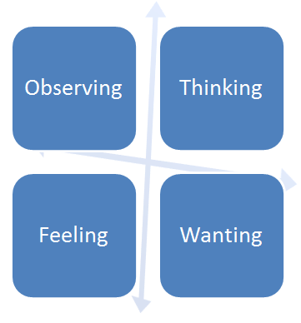

Slide 7

Let’s get into pairs:
Partner A
Partner B

Slide 8
What are you observing?

Slide 9
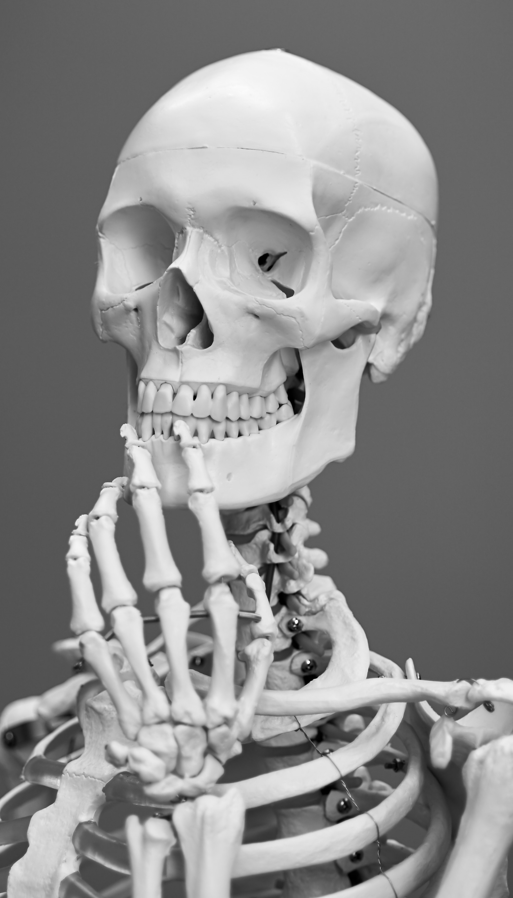
What are you thinking?

Slide 10

What are you feeling?

Slide 11

What do you want?

Slide 12

What stories are you making up?

Slide 13
Thank you

