Slide 1
Creating cultures of gentleness….the basics of gentle teaching
Dave Lappin – Executive Director
H.O.M.E. Society

Slide 2
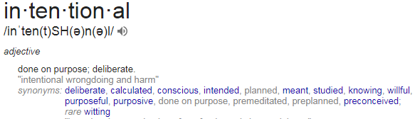
What does it mean to be intentional?

Slide 3
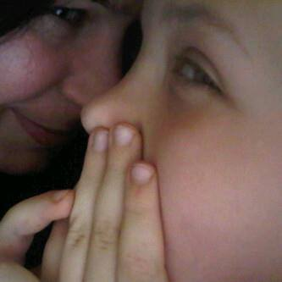
Being intentional is a choice
In every interaction we have with someone we have choice.
We can build someone up or we can tear someone down.
It is being mindful of the moments we are in and viewing each interaction as an opportunity to work on building a relationship and create new memories of safe and loved.

Slide 4


Slide 5


Slide 6

Tools of gentle teaching
Words
Hands
Eyes
Presence

Slide 7
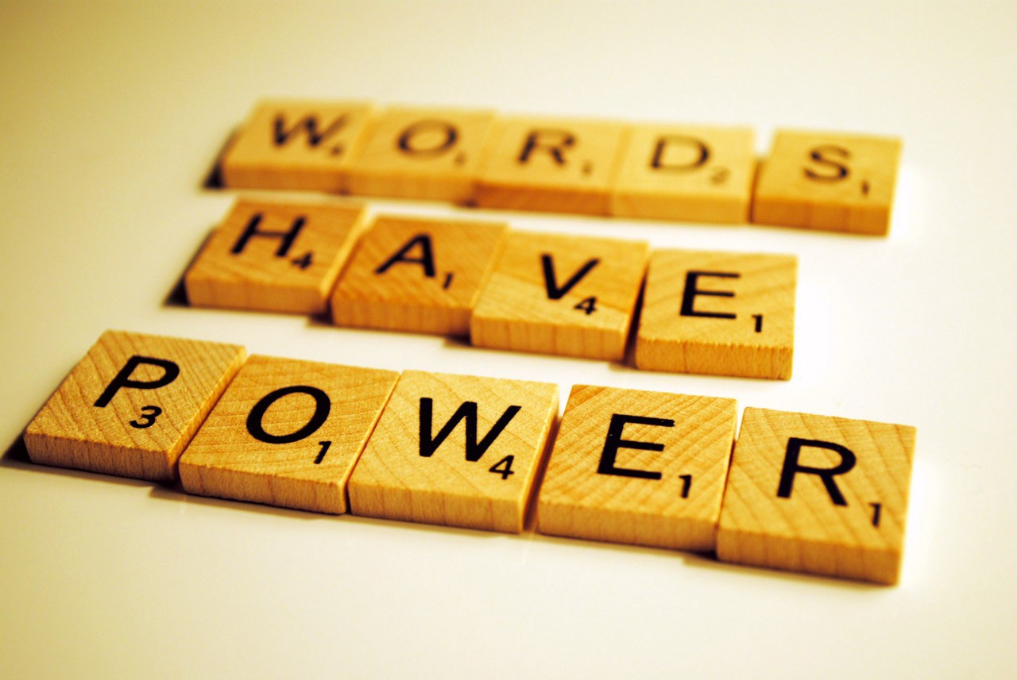
words

Slide 8
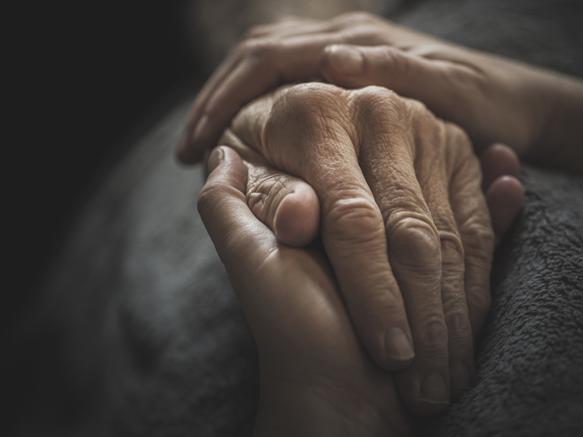
Hands

Slide 9

eyes

Slide 10

presence

Slide 11

Questions?

Slide 12


thankyou!
Dave Lappin
H.O.M.E. Society
Abbotsford BC, Canada
dave.lappin@homesociety.ca

