Slide 1
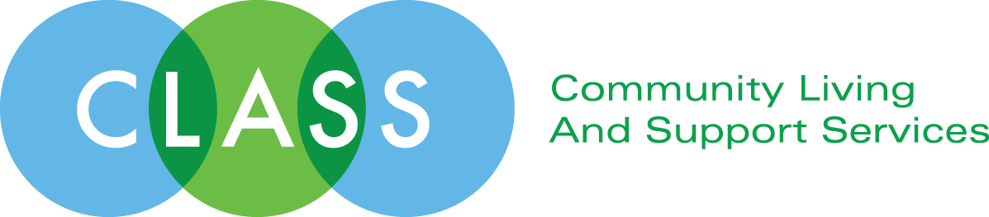
The Importance of Social Capital
Al Condeluci, PhD
CLASS

Slide 2
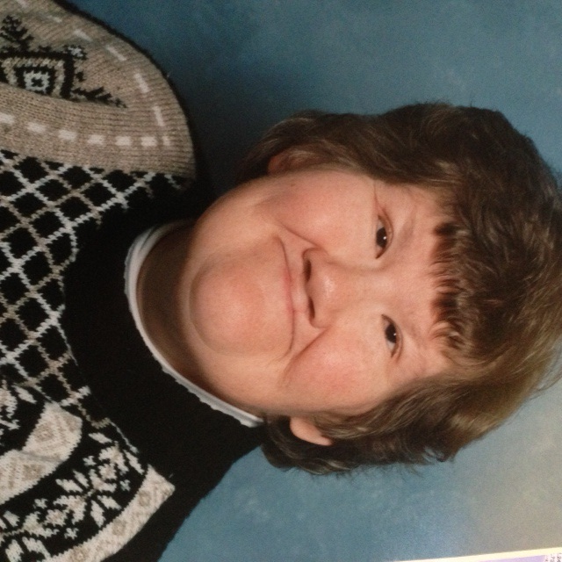

Slide 3
Difference
Rests in the person
Is key to their problems
Need to find ways to remedy it
Or, we need a special place for them

Slide 4
But sometimes, maybe most of the time, treating/fixing/changing difference really doesn’t work!
Maybe the real problem……is in the community!

Slide 5
From Micro to Macro
So if the problem isn’t the person, but found in the community, how can we change the culture?
We need to pass laws, to force people to change
Civil Rights – ADA – Fair Housing and Employment Laws

Slide 6
But, in the end, these don’t really work either. Laws can raise consciousness, but often, don’t change behavior.
“The more laws, the less justice” Cicero

Slide 7
What changes people’s behavior….is driven more by relationships – how others we respect behave – than by laws and formal efforts.
Sociologists call this “Social Influence Theory”
And it is rooted in the concept of SOCIAL CAPITAL!

Slide 8
Social Capital is…..
Friendships and relationships we develop and grow as we become members of various communities.
These relationships broaden our perspective and actually make our lives better! They change us!

Slide 9
Sociological Studies show that:
Healthfulness
Happiness
Longevity
Are all tied to – SOCIAL CAPITAL

Slide 10
Quite simply, the more social capital you have, the more healthfulness, happiness, and longevity you have!
But there is more!

Slide 11
Social Capital is also related to:
Tolerance – giving people a chance
Honesty – being truthful
Kindness – being nice
Compassion – caring about people
Fairness – doing the right thing
Integrity – being counted on

Slide 12
Finally, Social Capital assists with
People getting jobs
People keeping jobs
People being safe
People being psychologically stable
People framing their identity/self confidence
People advancing/achieving
Even test scores go up

Slide 13
“Without friends, the world is a wilderness”
Wadsworth

Slide 14
“If you belong to no group or community, and decide to join one, you cut your risk of dying in half over the next year”
Robert Putnam

Slide 15
So……how do we develop Social Capital
Quite simply……..
Through “Similarity”
And “Regularity”

Slide 16
Where we find Social Capital
Family
Neighborhood
Religious venues
Work
School
Clubs, Groups, and Associations

Slide 17
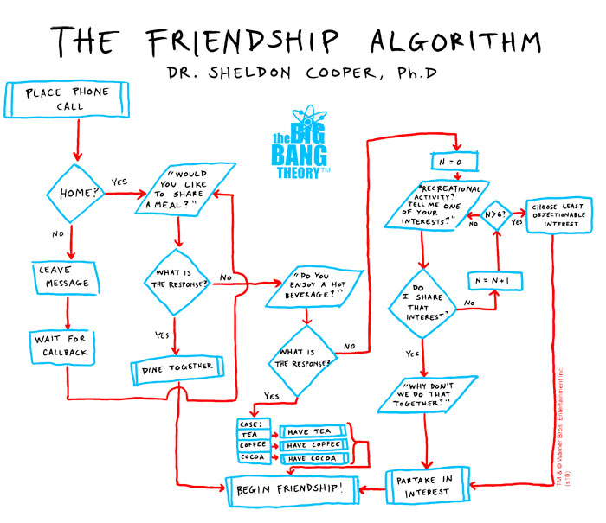

Slide 18
4 Steps to Social Capital
Identify our key areas of interest/affinities
Find the matching cluster/venue in community
Understand how communities behave
Finding a gatekeeper to acceptance

Slide 19
Gatekeepers
A natural player in a community who has influence on other members. They might be formal or informal players who set the tone for what others do in the community
Key theories here………Value juxtaposition

Slide 20
Keeping the Conversation Going
Regional Conversational Groups
Injecting Social Capital issues into existing groups
Developing a Junto
Considering a MeetUp groups
Developing a MeetUp group
Join the Interdependence Network – www.buildingsocialcaptial.org

Slide 21
The magic of Social Capital is when similarity overrides difference and creates a bridge. Through this bridge people begin to relate and that synergy promotes an upward effect for all.

Slide 22
Connection with another person takes you deeper into your own soul. Through others we get to know ourselves better. This deeper fulfillment is the fuel that helps us lead a better life as it enlivens our humanness. So connect with others, and do it often!

Slide 23
“What we do with our lives individually is not what determines whether we are a success. What determines our success is how we affect the lives of others”
Albert Schweitzer

Slide 24
Al Condeluci
4 Caldwell St.
McKees Rocks, PA 15136
412-848-0278
alcondeluci@alcondeluci.com
www.alcondeluci.com
@acondeluci on Twitter

